Slide 1
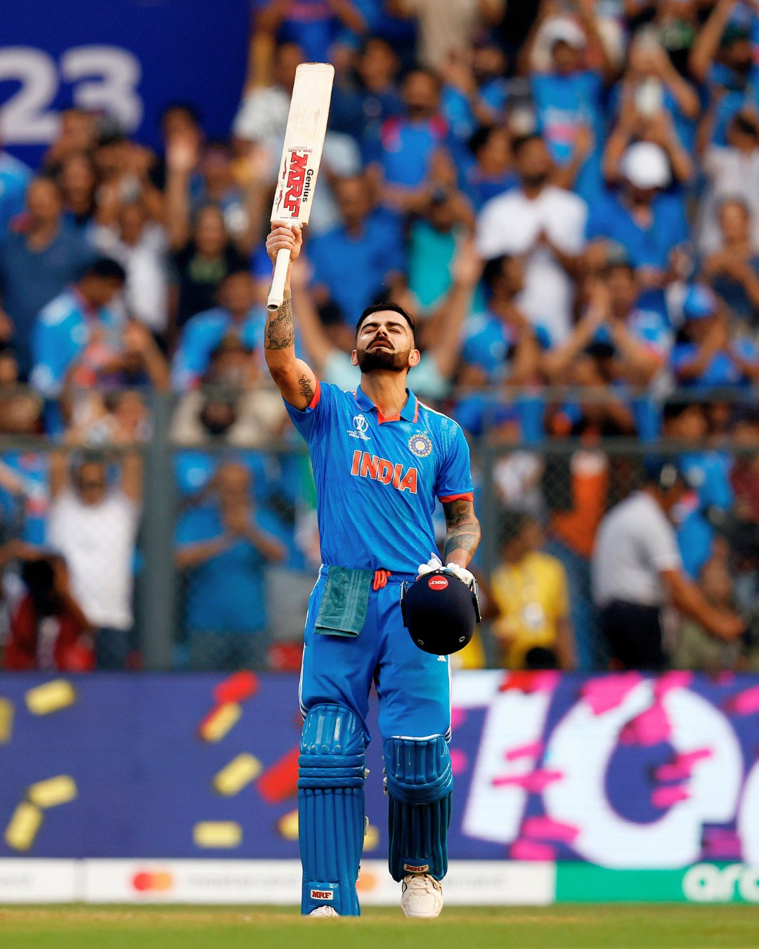
VIRAT KOHLI PERFORMANCE ANALYSIS
Presented by – Rahul Pandey
PRN - 23030141047

Slide 2
01
Introduction
Virat Kohli is celebrated as one of cricket’s greatest, with a decade-spanning career across all formats. His consistency, adaptability, and skill under pressure set him apart. To truly understand his impact, it's essential to analyze his performance across various situations.
The Virat Kohli Performance Analysis Dashboard provides a detailed overview of his career, offering insights into runs, averages, strike rates, centuries, and dismissals across formats. It highlights performance patterns at different venues, against various opponents, and in specific match contexts. This dashboard is a vital tool for analysts, strategists, and fans, enabling them to explore, celebrate, and predict Kohli's future contributions to the game.

Slide 3
02
Problem Statement
The evolving dynamics of cricket performance analysis pose significant challenges for sports analysts in deriving meaningful insights and enhancing player strategies. Without detailed breakdowns of Virat Kohli's performance across various parameters such as match contexts, venues, and opposition strengths, it becomes challenging to understand his adaptability and impact.
This lack of comprehensive analysis hinders the ability to make informed decisions regarding player development, match preparations, and strategic planning. Addressing these challenges is crucial for ensuring that Virat Kohli's contributions are maximized and leveraged effectively to maintain a competitive edge in international cricket.

Slide 4
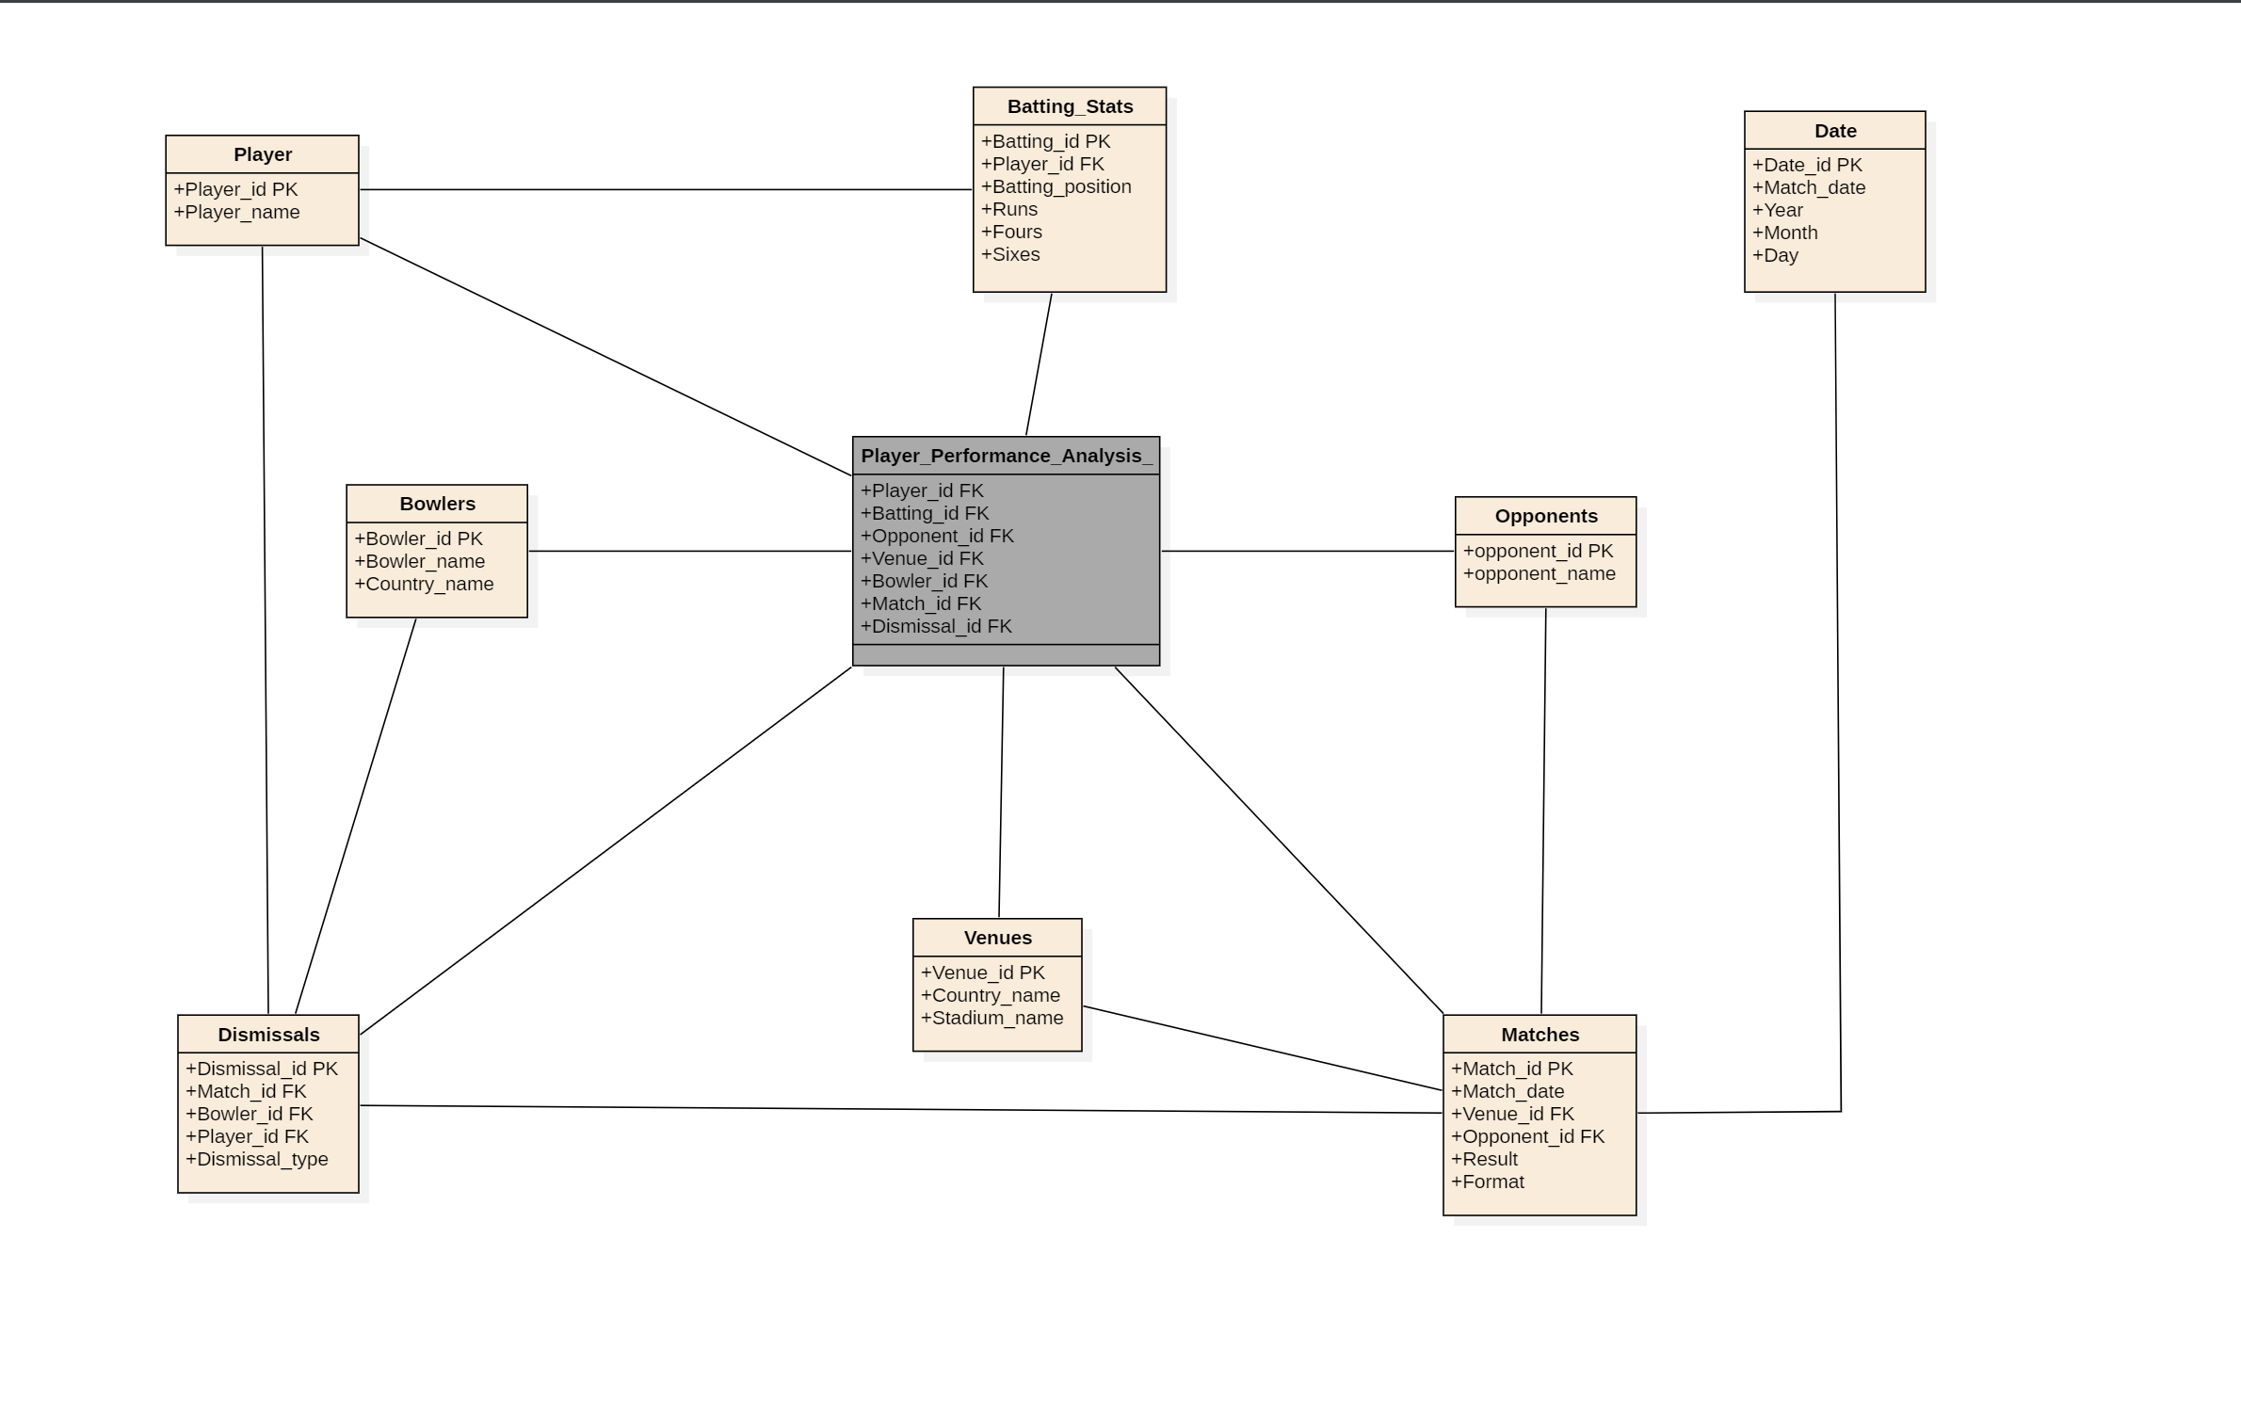
03
Data Warehouse Design

Slide 5
04
Data Information
Table Name | Attributes
Performance | Player ID, Batting ID, Opponent ID, Venue ID, Bowler ID, Match ID, Dismissal ID.
Player Info | Player ID, Player Name
Batting Stats | Batting ID, Player ID, Batting Position, Runs, Fours, Sixes.
Opponents | Opponent ID, Opponent Name.
Venues | Venue ID, Country Name, Stadium Name.
Bowlers | Bowler ID, Bowler Name, Country Name.
Matches | Match ID, Match Date, Venue ID, Opponent ID, Result, Format.
Dismissals | Dismissal ID, Match ID, Bowler ID, Player ID, Dismissal Type.
Dates | Match Date, Year, Month, Day.

Slide 6
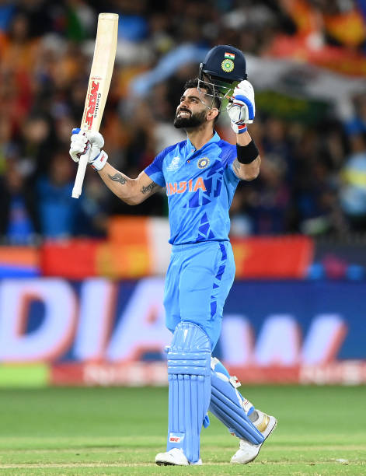
05
Key Performance Indicators
Total Runs
Batting Average
35,808
59.68
Centuries
Half-Centuries
157
158

Slide 7
06
Insights and Analysis
1
2
3
Top 10 Venues Where Virat Kohli Scored the Most Runs
Virat Kohli's Runs Against Each Opponent.
Yearly Batting Average Breakdown by Match Outcome
4
5
6
Top 10 Bowlers by Number of Dismissals Against Virat Kohli
Virat Kohli's Centuries: Analysis by Match Result and Format
Total Runs Scored by Virat Kohli Each Year

Slide 8
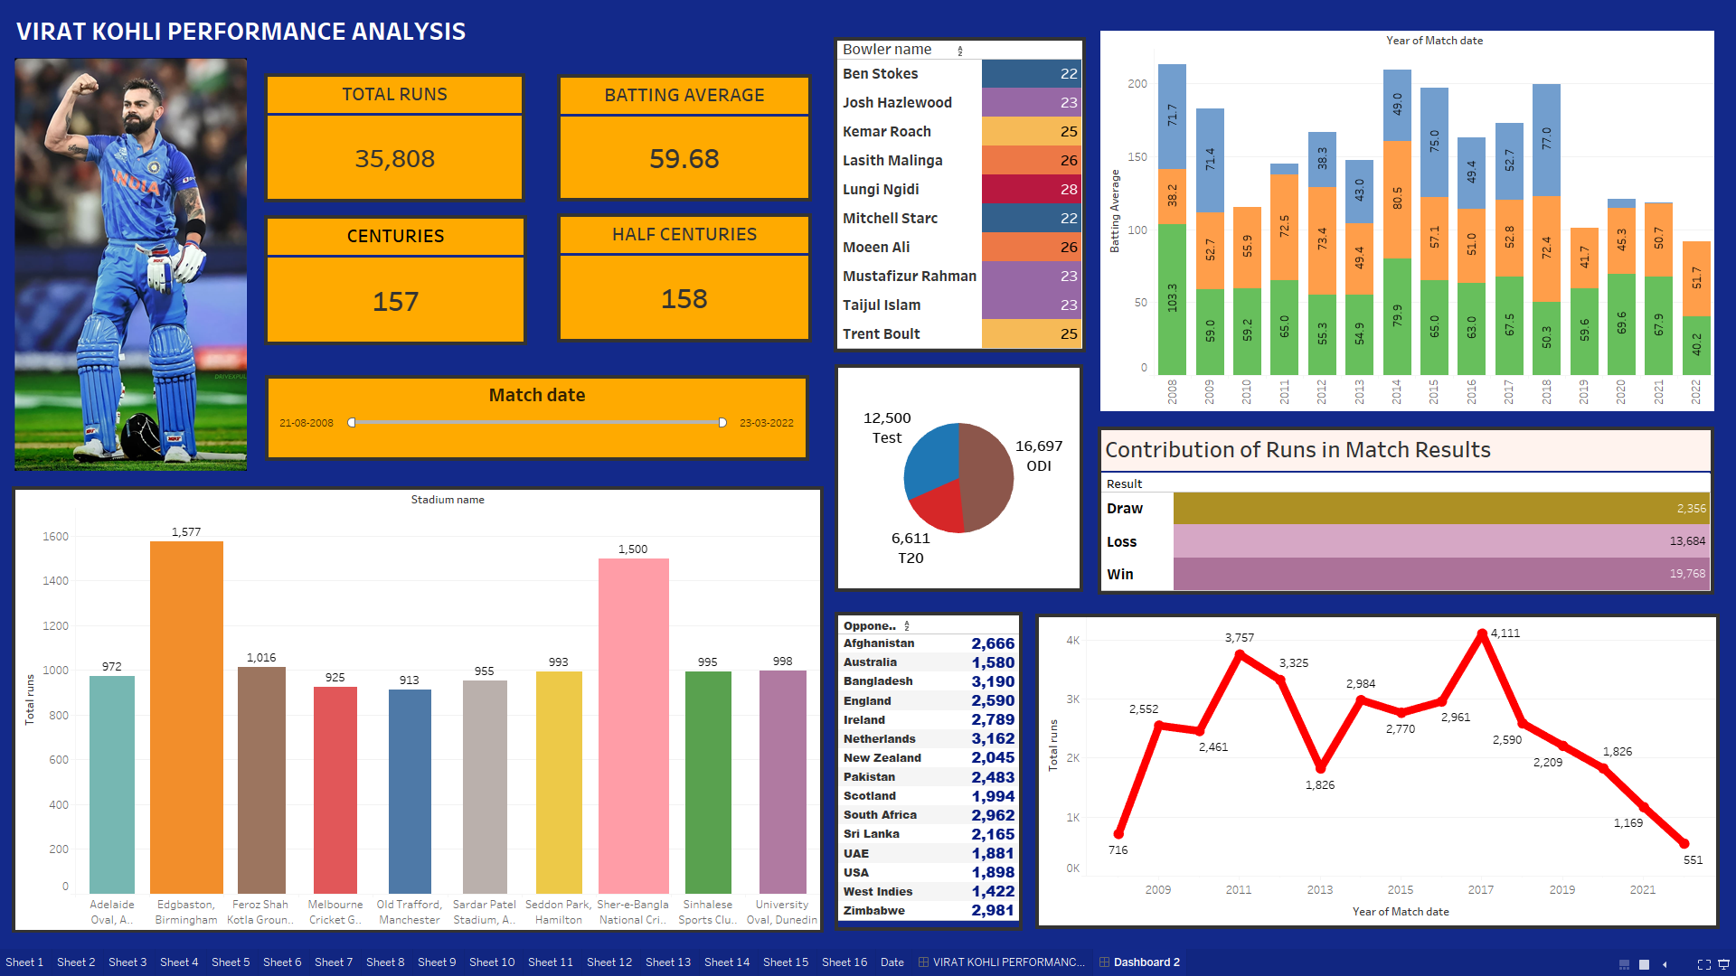
06
Dashboard

Slide 9
07
Conclusion
The Virat Kohli Cricket Performance Dashboard is an essential analytical tool that offers comprehensive insights into the cricketer's career. Designed for analysts, fans, coaches, and strategists, it visualizes key metrics like runs scored, batting positions, match formats, and performance against various teams. Users can explore trends, strengths, and areas for improvement by analyzing Kohli's performance across different formats, years, and venues.
The dashboard also enables strategic insights, such as Kohli's performance in specific stadiums or against certain bowlers, and allows comparisons with other players. Overall, it supports data-driven decisions and provides fans with a deeper appreciation of Kohli's impact on cricket.

